Slide 1
Food Waste Management Dashboard
Streamlit + MySQL Data Analytics Project
Created By:
AYUSH DASH

Slide 2
Introduction
This presentation outlines a Food Waste Management Dashboard built with Streamlit and MySQL to monitor listings, claims, and distribution.
It demonstrates analytics, SQL-driven insights, and actionable recommendations to reduce waste and improve coordination.

Slide 3

01
Overview

Slide 4

Title & Scope
Food Waste Dashboard centralizes provider and receiver data to track food availability, claims, and distribution.
Scope includes analytics, visualization, and SQL-based operational queries for monitoring and decision support.

Slide 5
Dataset Summary
Datasets: food_listings_data
providers_data
receivers_data
claims_data.
Includes listing metadata, provider locations, receiver details, timestamps, quantities, and claim records for trend and distribution analysis.

Slide 6
Technologies Used
Built with Streamlit (Python) and MySQL backend. Data processing via Pandas and visualizations with Plotly.
Designed for modular analytics, reusable SQL queries, and interactive dashboards.

Slide 7

01
Problem & Goals

Slide 8

Current Challenges
Large daily food waste with fragmented coordination between providers and receivers and no centralized monitoring.
This limits timely redistribution and data-driven oversight.

Slide 9
Project Objectives
Analyze food availability and track claims and distribution to identify waste patterns.
Deliver actionable insights and dashboards for improved coordination and reduced waste.

Slide 10
Success Metrics
Track Total Listings, Total Quantity, provider reach, and claim fulfillment rate.
Monitor reduction in unclaimed items and response time improvements to evaluate program effectiveness.

Slide 11

02
Dashboard Features

Slide 12
KPI Dashboard
Displays core metrics: total listings, quantities, active providers, and claims.
Provides at-a-glance performance with real-time counters and trend indicators.

Slide 13
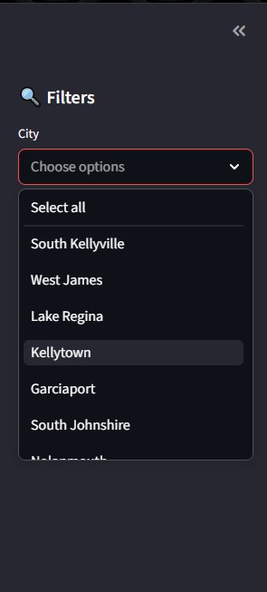
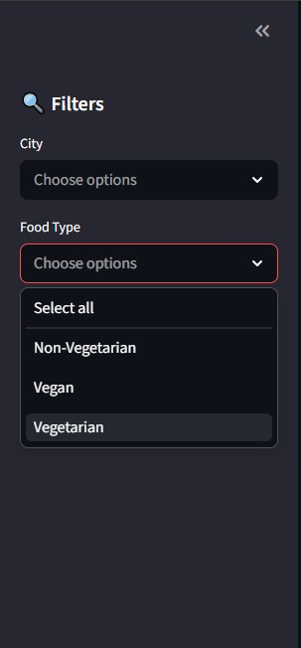
Filters

Slide 14
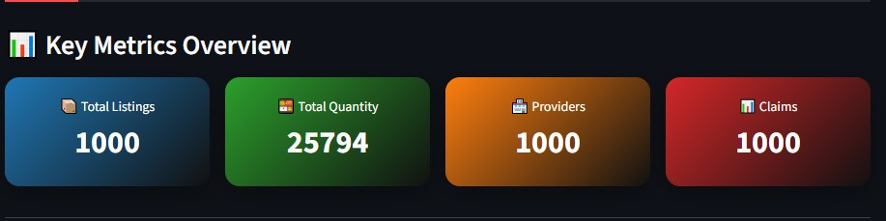
KPI Metrics

Slide 15

Visual Analyses
Time-series charts, distribution bar/pie charts, and geographic maps to reveal patterns.
Enables identification of peaks, high-waste areas, and top food types for targeted action.

Slide 16
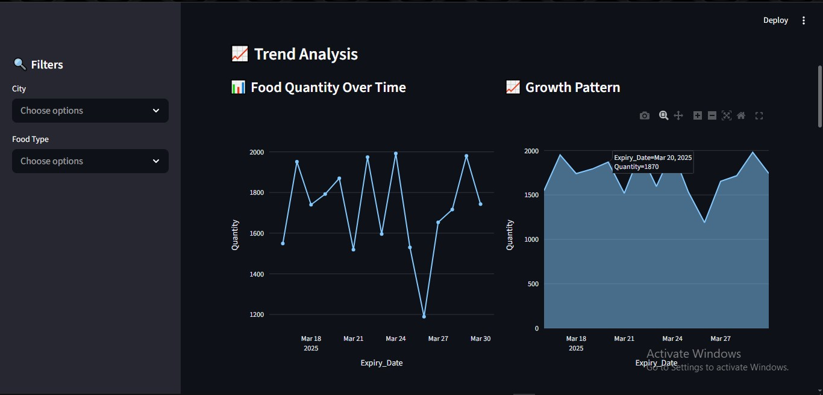
Trend Analysis

Slide 17
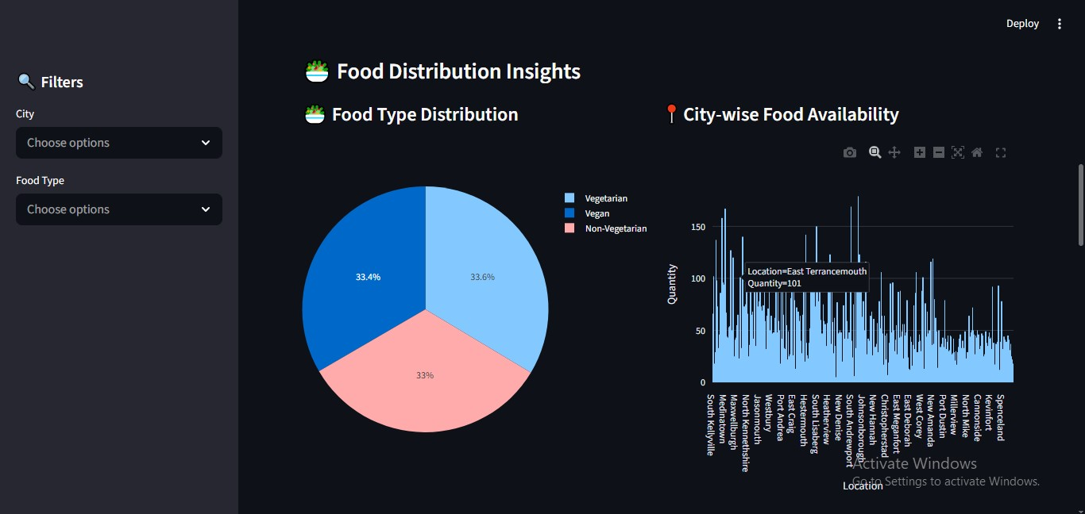
Food Distribution

Slide 18
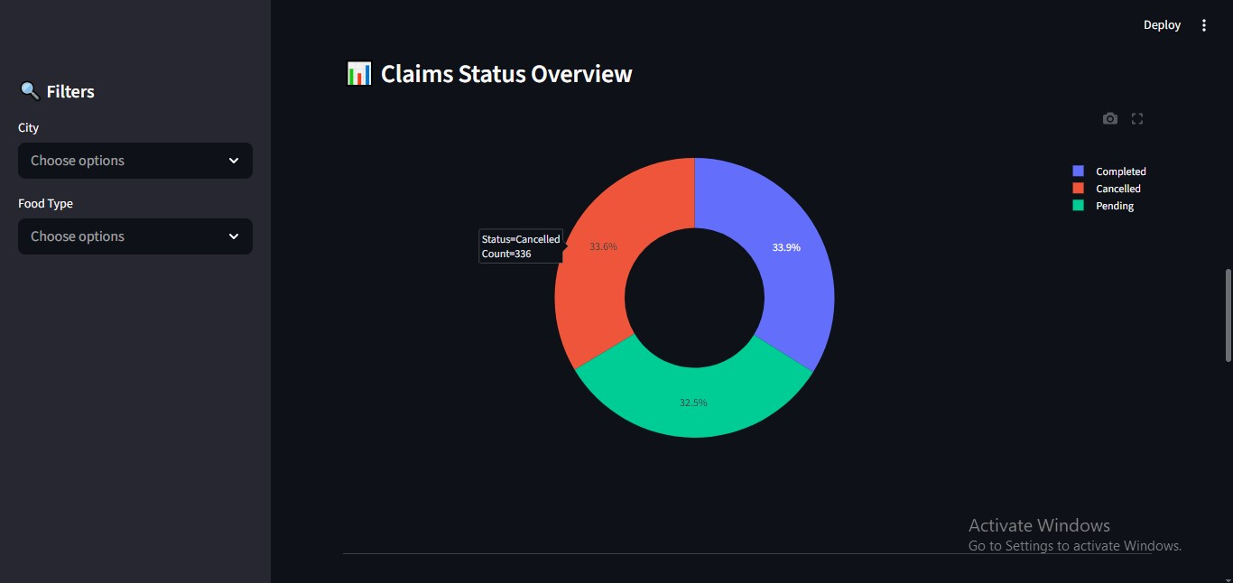
Claims Status

Slide 19
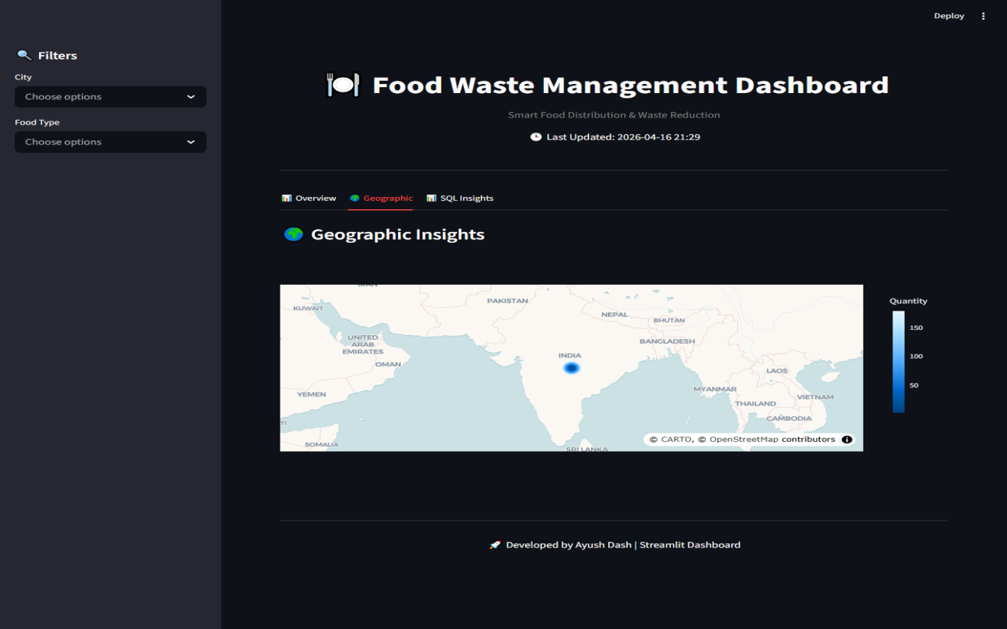
Geographic Insights

Slide 20
SQL Insights
Collection of 18 business queries for operational intelligence.
Includes provider performance, claim tracking, waste hotspots, and customizable ad-hoc analysis.

Slide 21
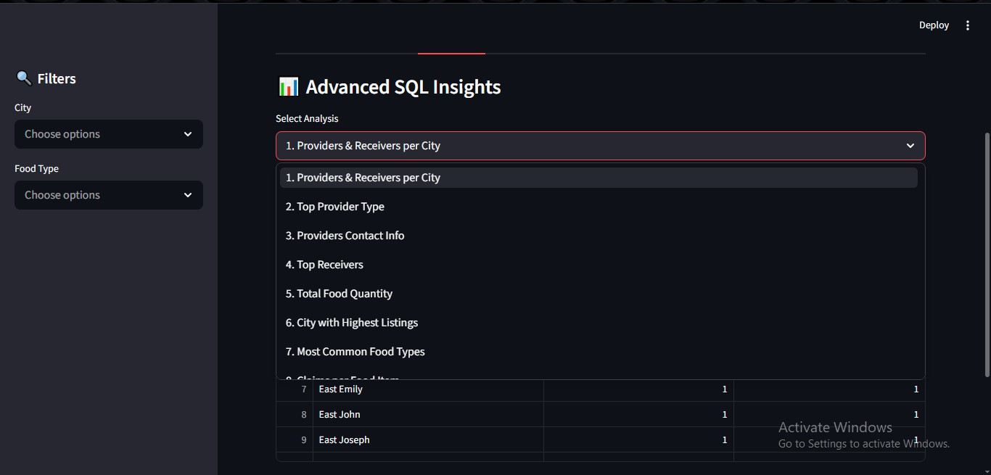
Advanced SQL Insights

Slide 22

03
Insights & Roadmap

Slide 23

Key Findings
Peak availability dates and top contributing providers identified.
Certain cities show consistently higher waste; demand trends reveal temporal mismatches.

Slide 24
Recommendations
Prioritize partnerships with top providers and redirect surplus to high-demand areas.
Implement targeted outreach on peak days and optimize pickup scheduling to reduce waste.

Slide 25
Future Enhancements
Develop AI prediction models for supply-demand forecasting.
Add real-time tracking, mobile integration, and alert systems for timely redistributions.

Slide 26
Conclusions
Dashboard centralizes food listing and claim data to enable data-driven decisions.
It reduces waste through improved coordination, actionable insights, and scalable SQL analytics.

Slide 27
Thanks!
Do you have any questions?

